Slide 1
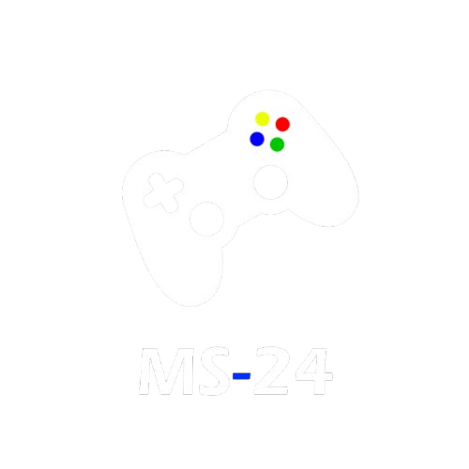
Steam
Groupe 2
tHibault Vivier
Mathis Carvalho
Rémy Courte
Campagne Marketing FIN 2024

Slide 2
SOMMAIRE
Introduction
Contexte
MS-24 App
Gestion de projet
Conclusion personnelle

Slide 3

Overcoming
Nervousness

Slide 4
Introduction

Slide 5




Introduction
Crash avion dataset avant Steam
Scrapping données via Python
Nettoyage & Transformation via PDI (ETL)

Slide 6
SELECTING VISUAL AIDS
ENHANCING YOUR PRESENTATION

Slide 7
contexte

Slide 8
COntexte
Développeur département Marketing
Préparation offre promotionnelle fin 2024
Type de studio ? Thématiques ?
Maximiser profit & satisfaction studio

Slide 9
MS-24 APP

Slide 10




Technologie
Framework MVC PHP
Front
Graphique

Slide 11
MAQUETTE
Symfony (framework MVC PHP)
HTML – CSS – JavaScript - Twig
R

Slide 12
DEVELLOPEMENT
Symfony (framework MVC PHP)
HTML – CSS – JavaScript - Twig
R

Slide 13
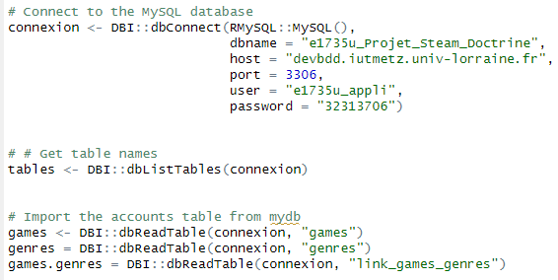
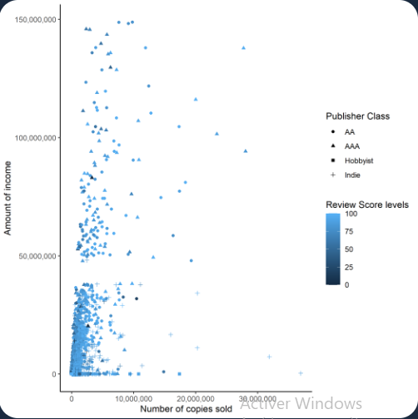
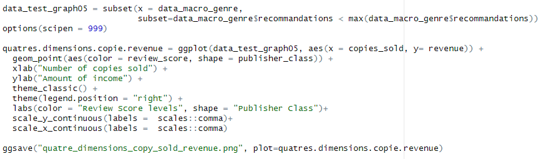
Application
Graphiques R : Ggplot2

Slide 14
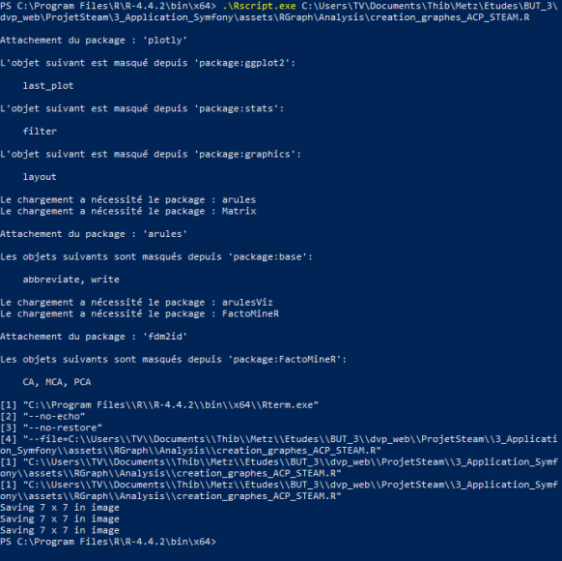
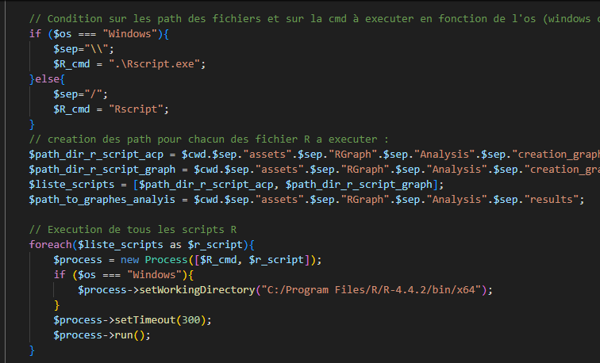
Application
Execution des scripts R

Slide 15
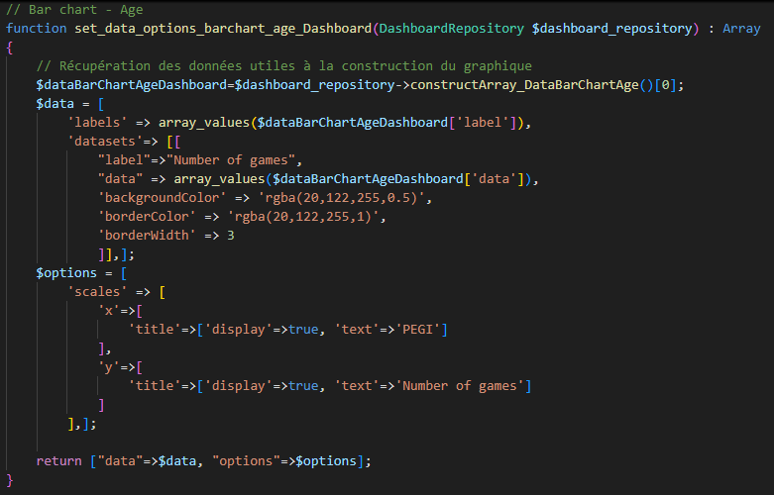
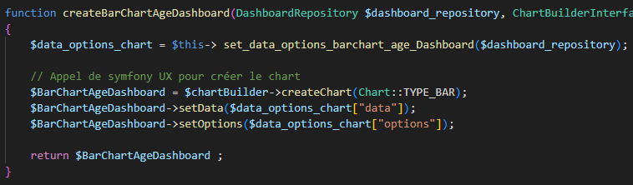
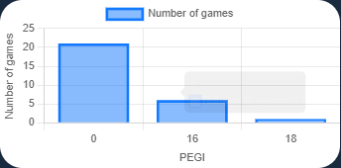
Application
Chart JS

Slide 16
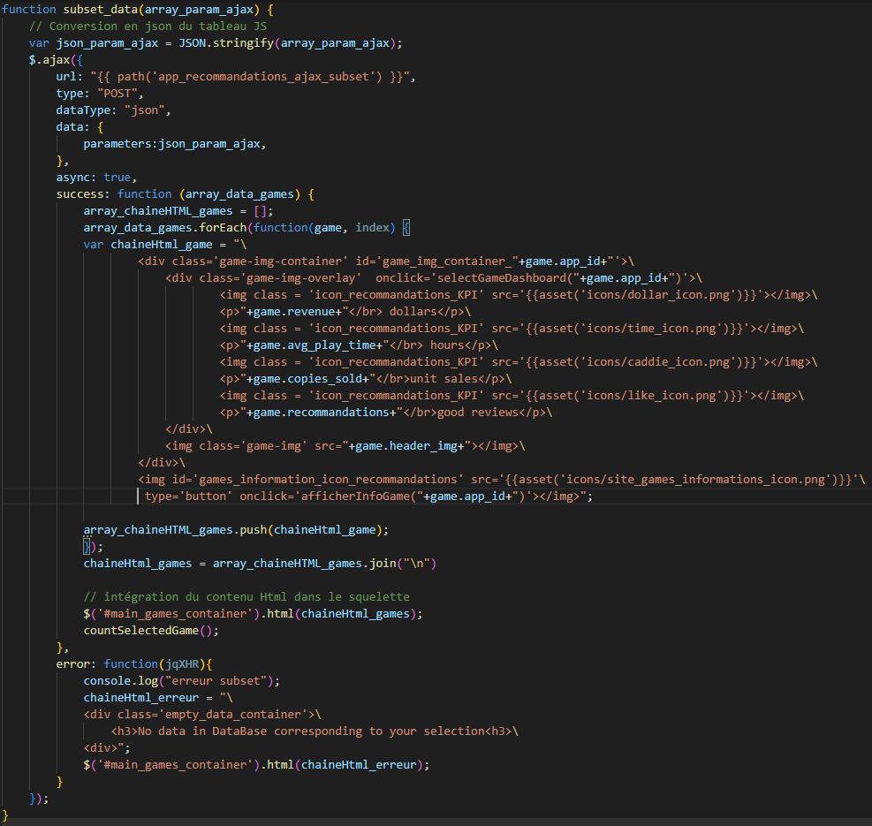
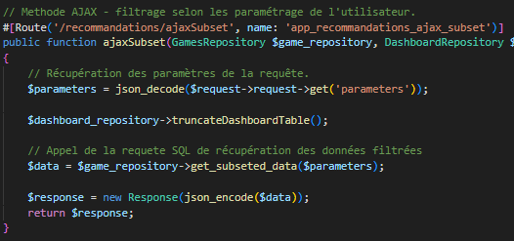
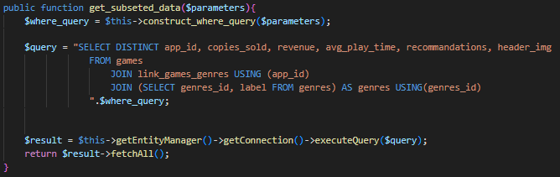
Application
Requêtes ajax

Slide 17
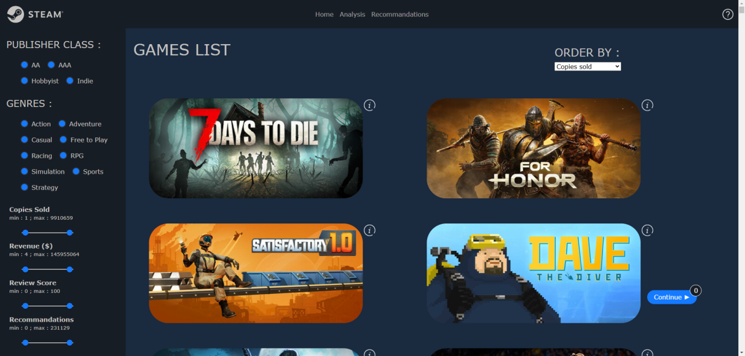
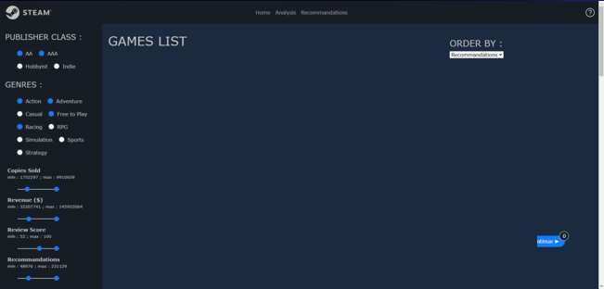
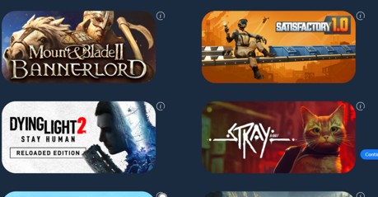
Application
Requêtes ajax

Slide 18
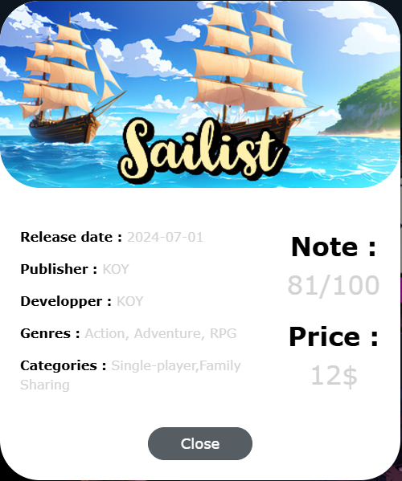
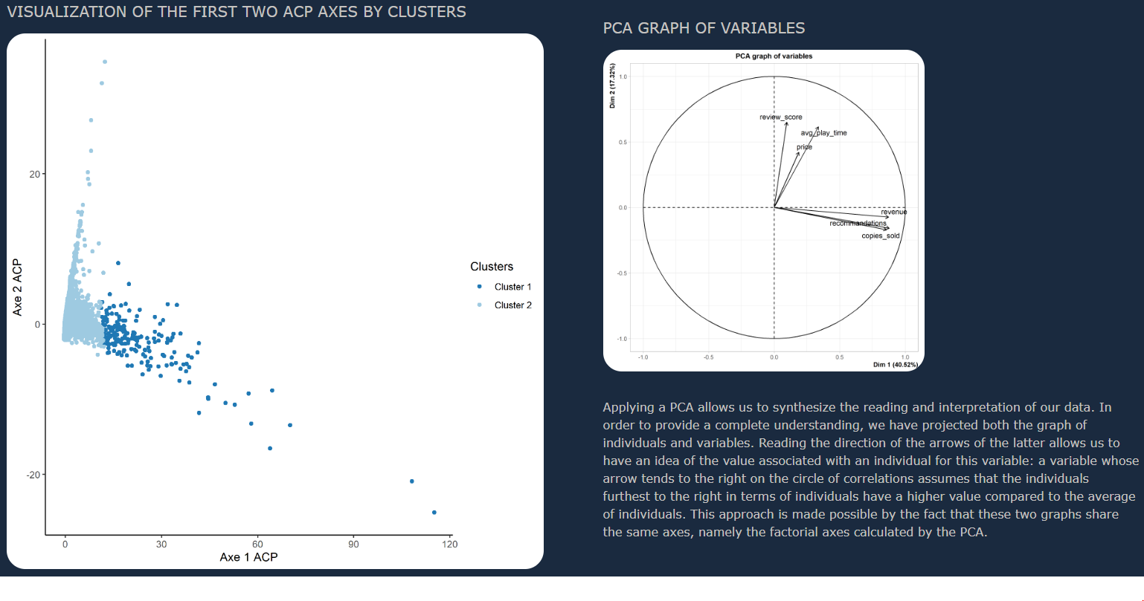
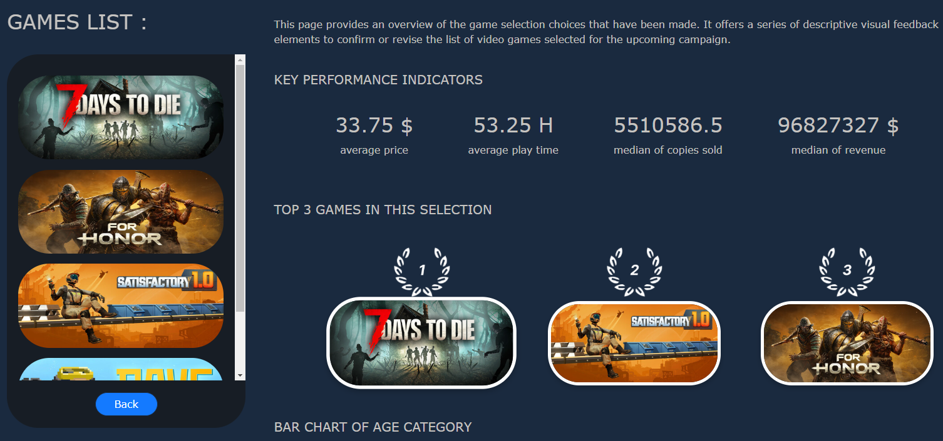
Application CSS

Slide 19
Screen figma + appli MS + vrai site steam pour montrer travail visuel

Slide 20
INTERPRéTATION
A faire

Slide 21
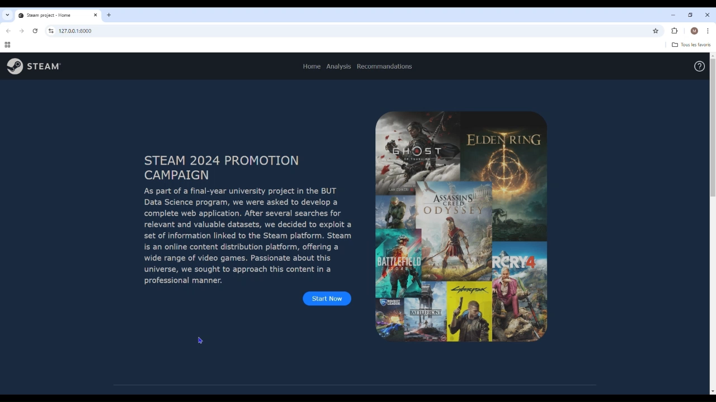
Démonstration vidéo

Slide 22
DéMONSTRATIOn VIDEO

Slide 23
Gestion du projet

Slide 24







Gestion du projet
Collaboration
Run
Expert

Slide 25
Conclusion personnelle

Slide 26


Rémy
Enrichissant car from scratch
Décalage rythme Thibault & moi
R & ggplot2, CSS, PHP & POO

Slide 27
Mathis
Apprendre par soi-même
Rythme différent au début
Répartition travail difficile au début
Découvertes technologies (GitHub, PHP, Symfony)
Améliorations CSS & POO

Slide 28
PARTIE PERSO MATHIS ET THIBAULT

Slide 29
DYNAMIC DELIVERY
METRIC | MEASUREMENT | TARGET | ACTUAL
Audience attendance | # of attendees | 150 | 120
Engagement duration | Minutes | 60 | 75
Q&A interaction | # of questions | 10 | 15
Positive feedback | Percentage (%) | 90 | 95
Rate of information retention | Percentage (%) | 80 | 85
Learn to infuse energy into your delivery to leave a lasting impression
One of the goals of effective communication is to motivate your audience

Slide 30
FINAL TIPS & TAKEAWAYS
Consistent rehearsal
Strengthen your familiarity
Refine delivery style
Pacing, tone, and emphasis
Timing and transitions
Aim for seamless, professional delivery
Practice audience
Enlist colleagues to listen & provide feedback
Seek feedback
Reflect on performance
Explore new techniques
Set personal goals
Iterate and adapt

Slide 31
SPEAKING ENGAGEMENT METRICS
IMPACT FACTOR | MEASUREMENT | TARGET | ACHIEVED
Audience interaction | Percentage (%) | 85 | 88
Knowledge retention | Percentage (%) | 75 | 80
Post-presentation surveys | Average rating | 4.2 | 4.5
Referral rate | Percentage (%) | 10 | 12
Collaboration opportunities | # of opportunities | 8 | 10

Slide 32

MERCI POUR VOTRE ECOUTE !

